Slide 1
Canberra Old Oak Surgery
PATIENT PARTICIPATION GROUP (PPG)
Thursday 13nd October 2022
Time 13:00pm

Slide 2
Introduction
Welcome to Canberra Old Oak Surgery’s PPG Meeting
It is very important that we continue to have these meetings to give patients and practice staff the opportunity to meet and discuss topics of mutual interest with patients.
Please remember that this meeting is not about complaints or personal issues.
To provide a means for patients to become more involved and make suggestions about the healthcare services they receive.

Slide 3
Canberra Old Oak Surgery’s Team
Clinical Team | Job role
Dr Ahmed Mudei | General Practitioner
Dr Amit Singh | General Practitioner
Dr Aalya Qureshi | Long term Locum GP
Dr Luma Ali | Long term Locum GP
Elham Nagetpour ( NEW) | Pharmacist
Bhumi Rana | Pharmacist
Elena Coronado | Practice Nurse
Amparo Belda Arribas | Practice Nurse
Ghazaleh Pardakhtchi | Physician Associate
Nadine Owareh-Mensah | Physician Associate
Beatrice Abakah | HCA
Admin Team | Job role
Abu Osman | Regional Manager
Agnieszka Jaruga | Deputy Regional Manager
Abid Khan | Assistant Practice Manager
Nadeem Ali | Practice Administrator
Paige Lambert | Practice Administrator
Tasnim Khanom | Senior Receptionist
Akida Gardiner | Senior Receptionist
Omar Said | Receptionist
Denny Joseph | Receptionist
Mohammed Khan | Receptionist
Daniel Morris | Receptionist
Fatma Ahmed | Receptionist /HCA

Slide 4
Canberra’s Vision
Improve access to patients with better telephone access, a range of appointment types, and great communication
Engage with patients about their health and the services we provide in order to improve health proactively
Optimise the management of Long term conditions
Work in a multidisciplinary team to ensure the best care
Work closely with CCG (Clinical Commissioning Group) and PCN (Primary Care network) and Community to offer the best service possible

Slide 5
What is a PPG A Patient Participation Group (PPG) is a group of patients, carers and GP practice staff who meet to discuss practice issues and patient experience to improve the service.
PPG for Practice
PPG for Patients
Develops a partnerships with patients
Support health awareness and patient education
Listen to patients feedback
Patients to be more involved and make suggestions about the healthcare they receive could be improved
Feedback on patient experience to help improve the service

Slide 6
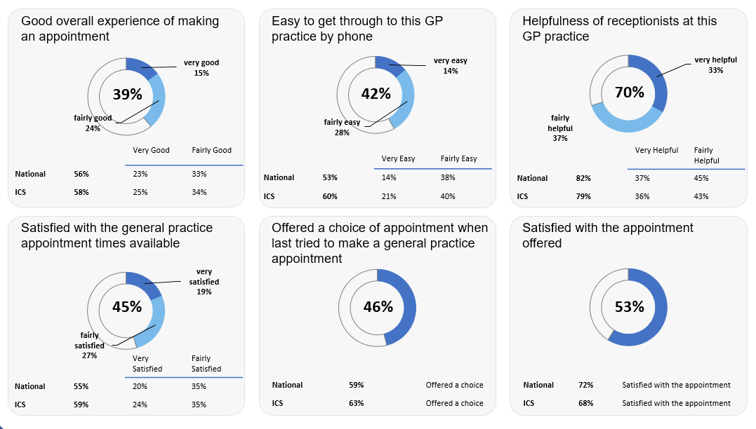
GP Patient Survey
The GP Patient Survey is an independent survey run by Ipsos Mori on behalf of NHS England. 859 surveys was sent to Canberra Old Oak Patients and only 103 surveys were sent back.

Slide 7
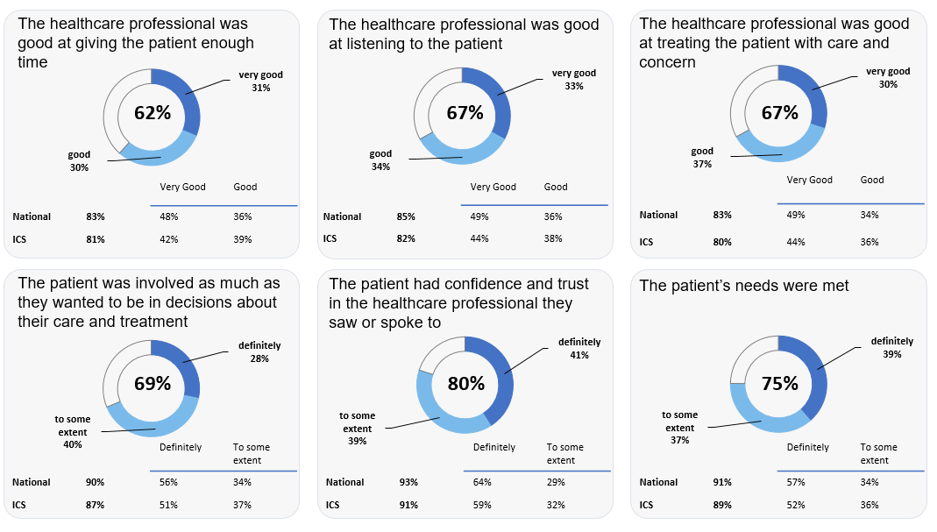
GP Patient Survey

Slide 8
You Said / We Did
You said : You needed more access and variety of choices for appointments .
We Did : We recruited two full time pharmacists, 1 part time pharmacist.
In addition, we are able to book Face to face and telephone appointment Monday to Friday (18:00-20:00) and Saturday( 09:00-20:00) and Sunday ( 0800 – 1400 )
You said : You find it hard to get through on the phone and didn’t find our receptionist friendly
We Did : We recruited two new receptionists .
We regularly monitor calls queues to ensure we are picking up phones in a timely manner .
We arranged customer service refresher training for all our staff

Slide 9
You Said / We Did
You said : your health professional did not listen to your concerns and did not involve you in the treatment plan
We Did : Your feedback was discussed with our clinical team who reflected on their consultation and our Regional Medical Director has been sharing tips on how to improve the consultation experience for our patients

Slide 10
Covid 19 Booster
Covid 19 boosters are now available from most local pharmacies. The autumn booster jab is being offered to those at high risk of the complications of COVID-19 infection, who may have not been boosted for a few months.
You can book this via the NHS England website. Alternatively, you can call 119 and they will be able to book you. A member of the reception staff from Canberra will be able to help with further questions if needed.
The nearest Pharmacist that provide the booster are:
Hamlins Vaccination Hub
Greenlight Pharmacy
Marcus Jones
Winwood Chemist

Slide 11
Influenza (Flu Jabs)
The practice has started to offer flu jabs for the following patients:
Are 50 and over (including those who will be 50 by 31 March 2023)
Have certain health conditions
Are pregnant
Are in long-stay residential care
Receive a carer's allowance, or are the main carer for an older or disabled person who may be at risk if you get sick
Live with someone who is more likely to get a severe infection due to a weakened immune system, such as someone living with HIV, someone who has had a transplant, or is having certain treatments for cancer, lupus or rheumatoid arthritis
If you would still like to have the flu jab please contact your local pharmacy who might charge you a fee.

Slide 12
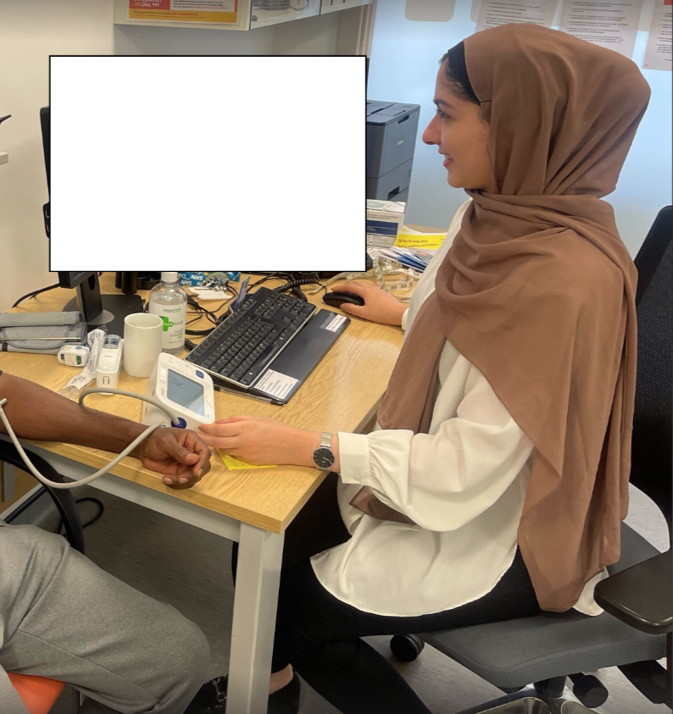
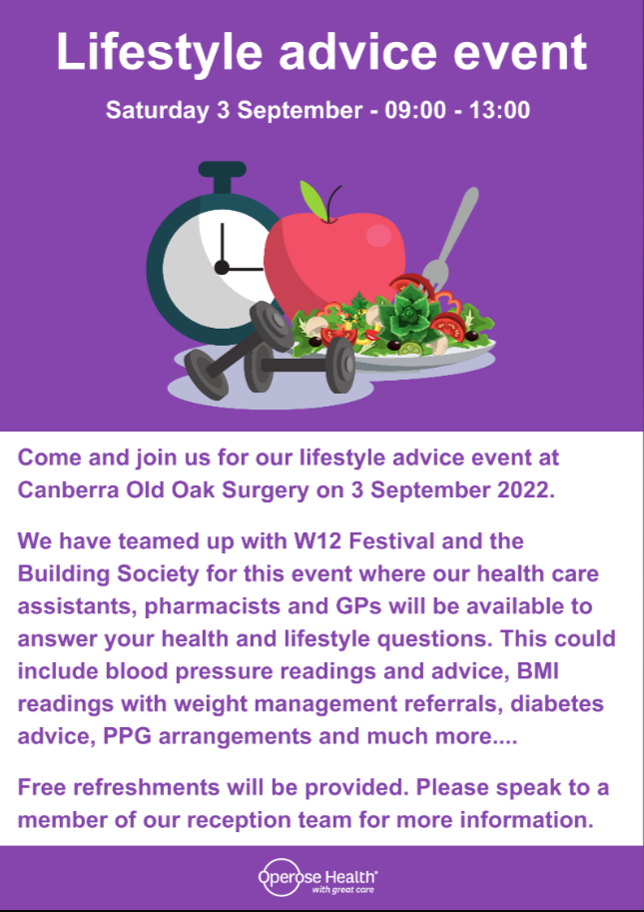
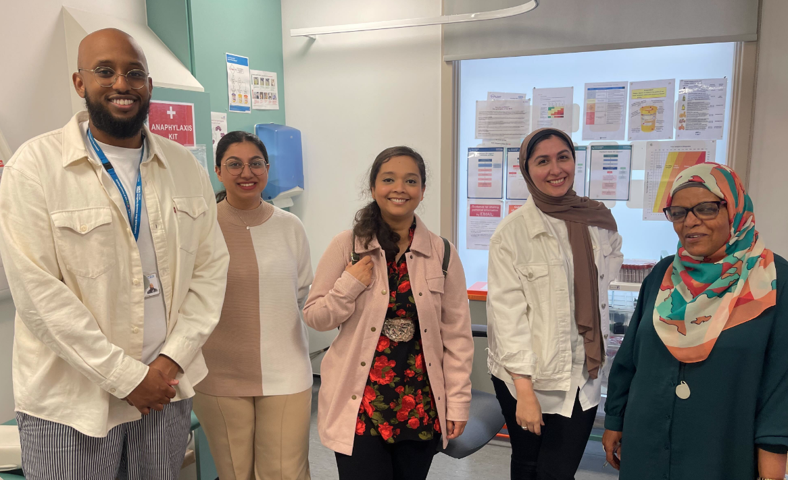
Lifestyle advice event

Slide 13
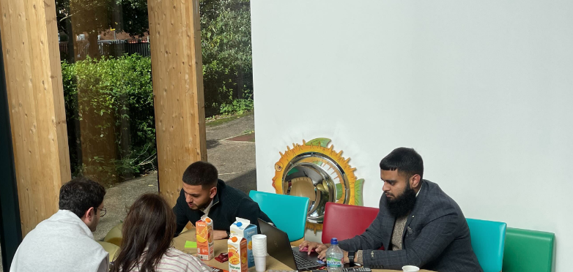
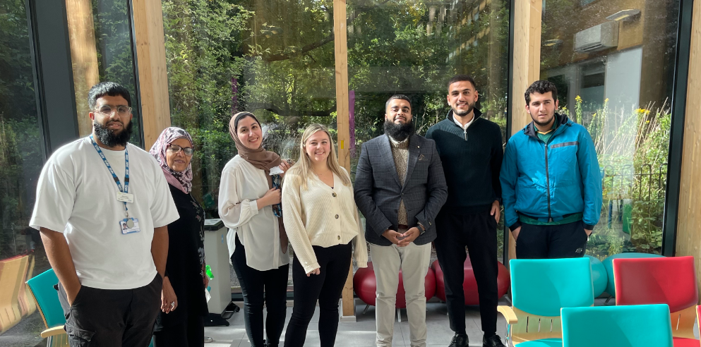
DR IQ Orientation Day
Helped patients get registered on DR IQ and showing others how to make the best use of DriQ
Feedback from patients:
More Languages on the app to make it accessible
Ability to book appointments directly on DriQ.
View their medical records on DriQ

Slide 14
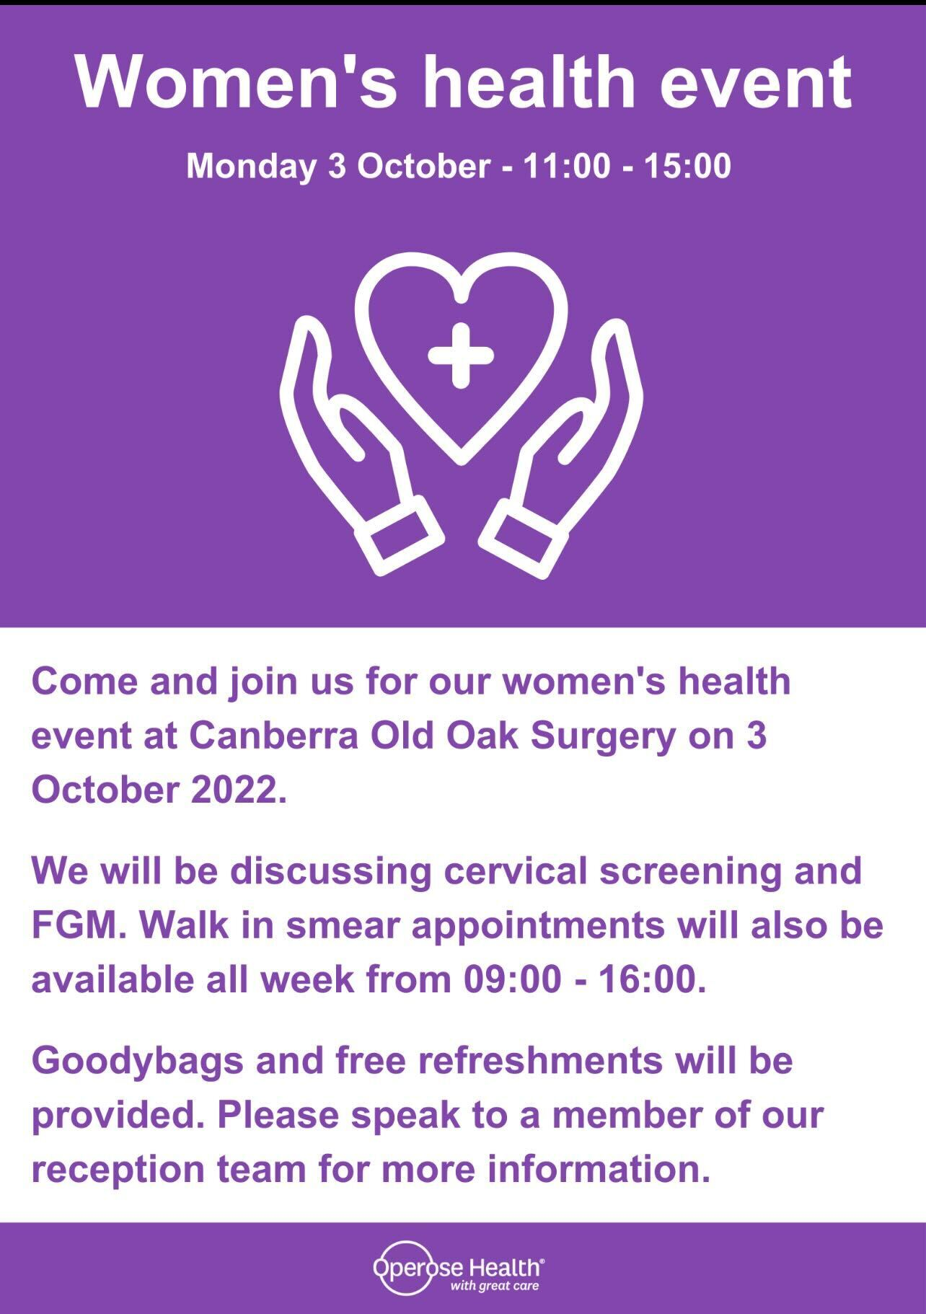
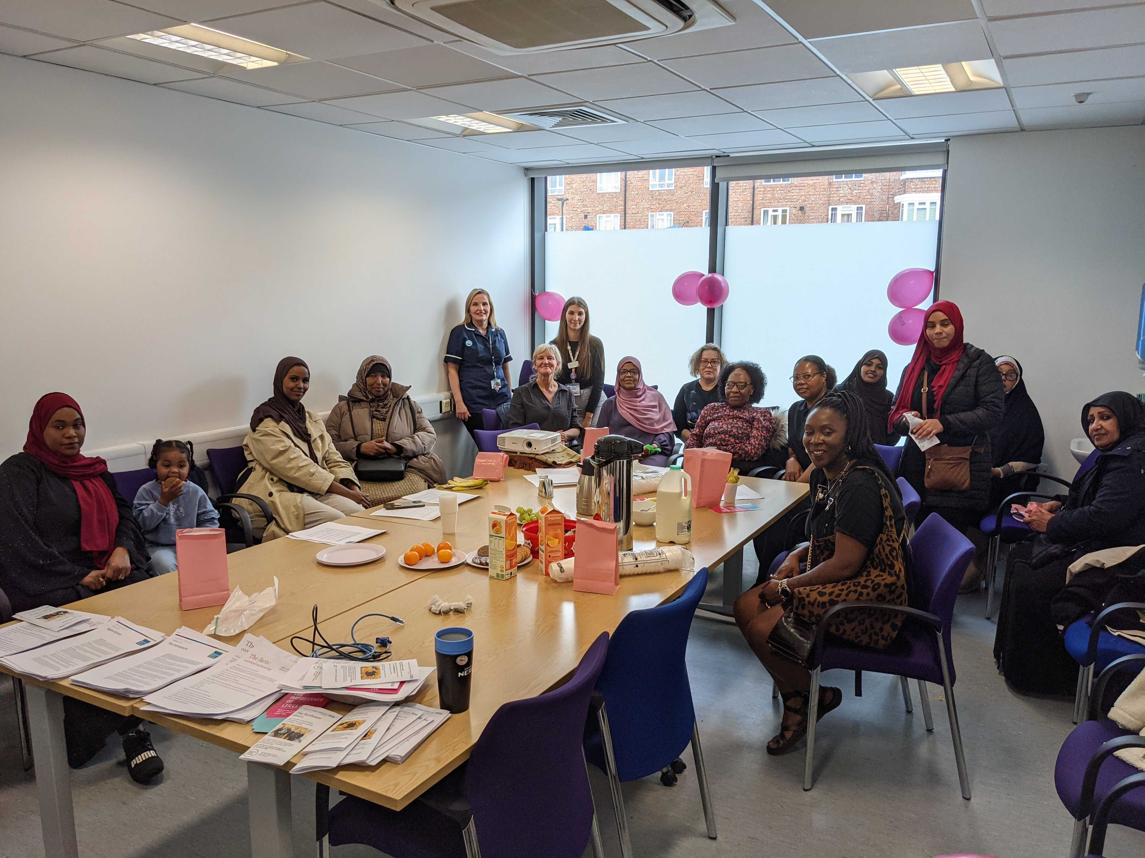
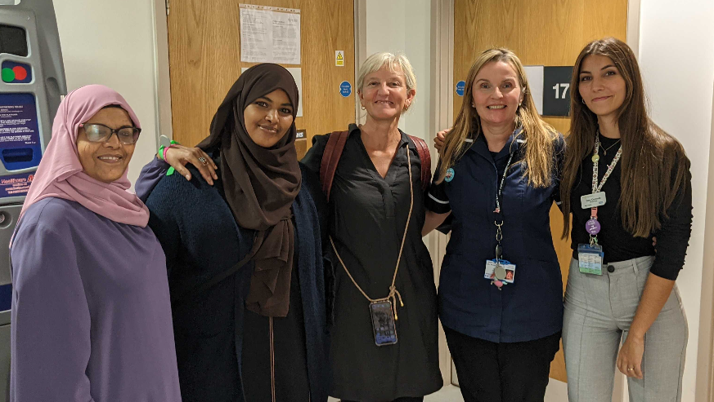
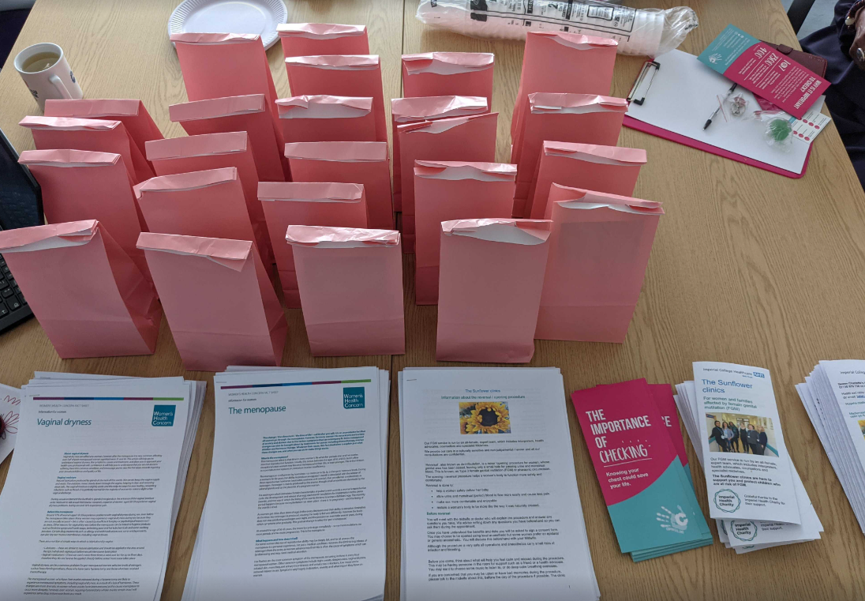
Women’s Health / Cervical Cancer Screening Awareness Week

Slide 15
Future Events
We will be holding future events as seen by the success of our past events , the following event will be planning to hold before the next PPG meeting are:
Community Walks ( every Thursday / Friday at 1230 )
DR IQ Training sessions
New Diabetes Diagnosis sessions

Slide 16
Questions

